Slide 1

PROJECT PRESENTATION GROUP -12 Customer Churn Prediction for Bank in the U.S.A Market
Varun Simha Reddy Thippreddy Santhoshi Kareddy Venkata Sai Karthik Aleti
Naveen Ajay Karasu
Gnana Naga Siva Sankar Kuralla

Slide 2
Introduction
Our project aim is to study different things, behavior from day to day activities of the user to understand more clearly that why the customer churn is happening.
we can call it as a binary classification problem, making machine learning algorithms like decision trees, Random Forest classifier, and neural networks as suitable candidates
The analyzing done on different factors like demographics, account activity, product usage etc..,.
We think this predictive capability can empower banks to implement targeted different strategies, to reducing churn and enhancing customer loyalty.

Slide 3
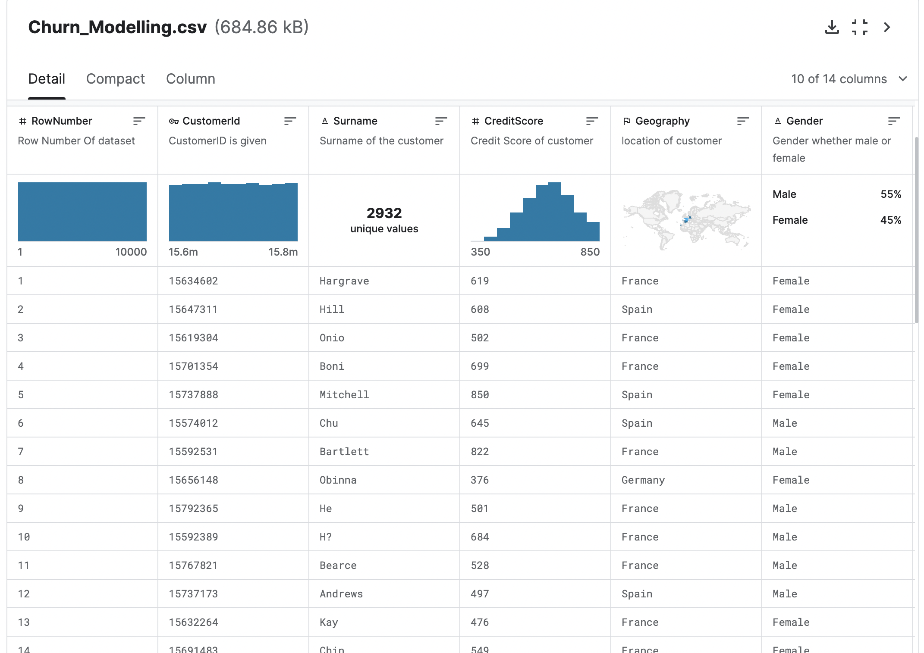
DataSet
This dataset is originated from a U.S. bank .
The dataset consists of ten thousand variables with 14 different columns.
Various Bank detail is given like Customer ID , surname, Credit score and many more.

Slide 4
Data Exploration for Churn Prediction
Dataset Analysis: Analyzing customer demographics, financial details, and account activity helps in understanding the reasons for customer churn.
Feature Analysis: In-depth analysis of the dataset's features helps differentiate their distributions and inter-relationships, providing insights into potential predictive factors.
Data Pre-processing: Techniques such as data normalization and scaling are employed to ensure that each feature contributes equally to the model's prediction.

Slide 5
MACHINE LEARNING TECHNIQUES
Random Forest
Decision Tree
XG Boost

Slide 6
FLOW CHART
Data Loading
Data Pre Processing
Hyper Parameter Tuning
Model Training & Prediction

Slide 7
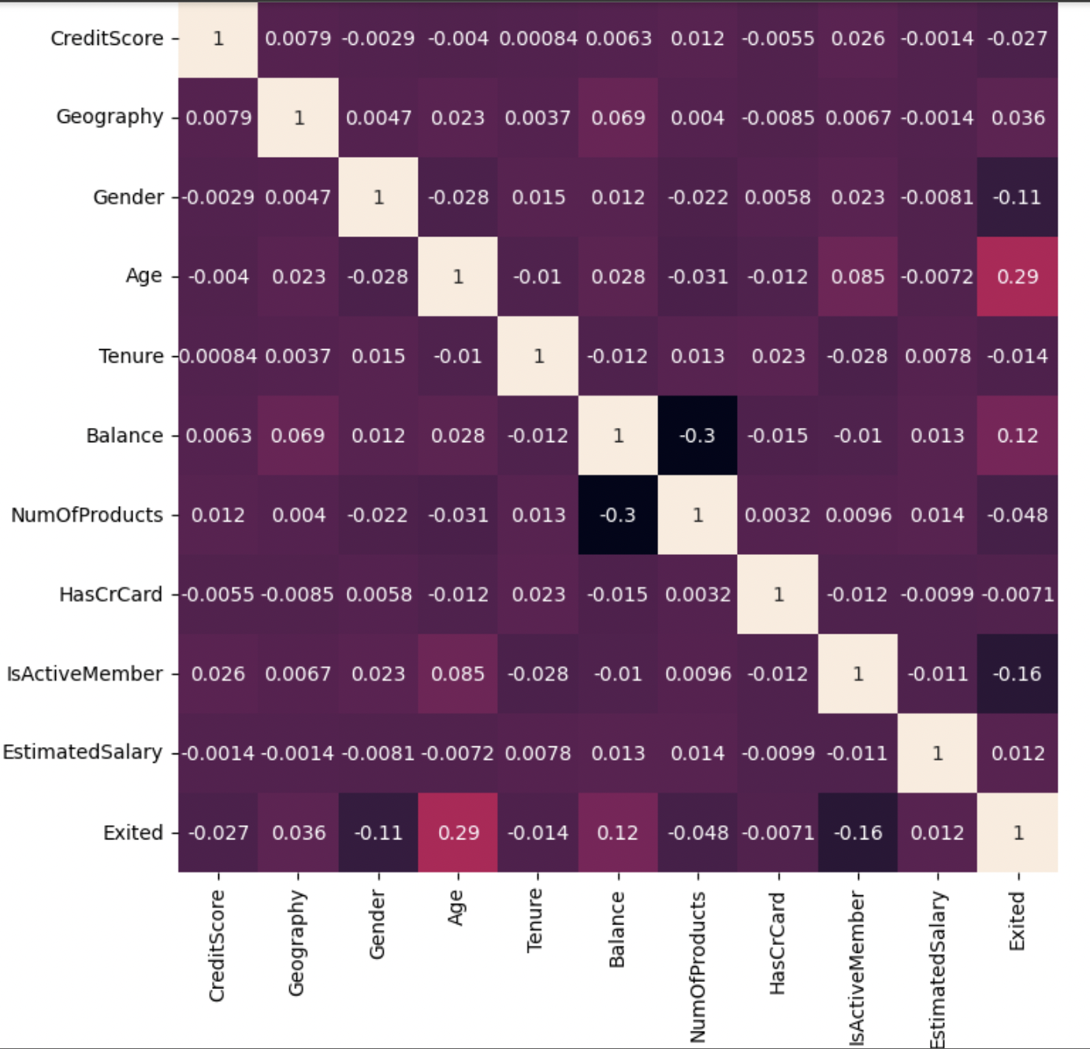
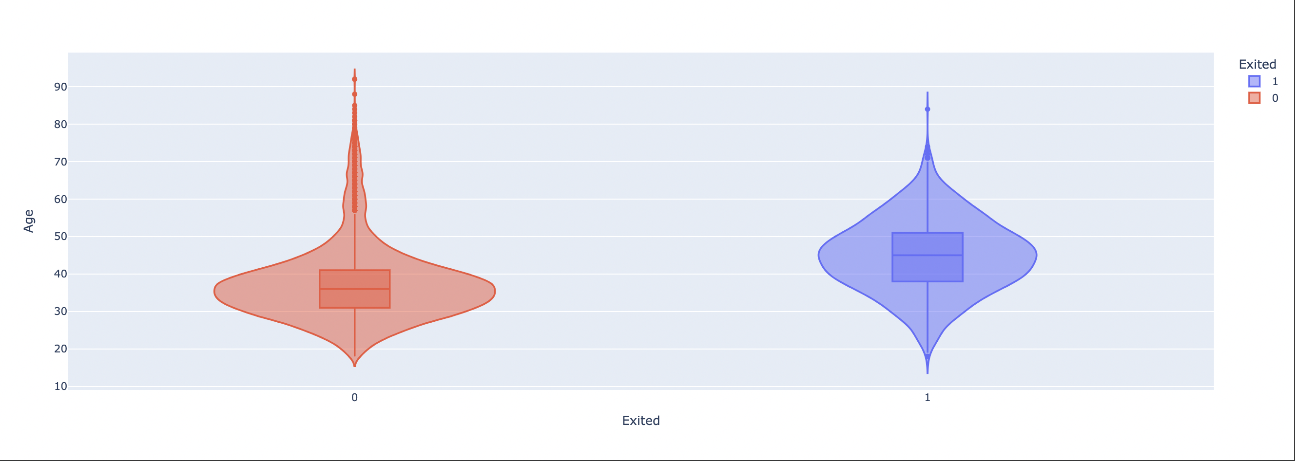
Visualization Plots

Slide 8
Model Implementation
Machine Learning Models: Utilizing techniques such as XGBoost, Random Forest, and Decision Tree for predicting customer churn based on customer demographics, financial details, and account activity.
Hyperparameter Optimization: Exploring the importance of hyperparameter optimization in building accurate machine learning models.
Visualizations: Presenting results through visualizations, including KDE plots and ROC curves, to demonstrate the performance and accuracy of the models used.
Random Forest Model: Identified as the best model for predicting customer churn, showcasing promising outcomes and accuracy.

Slide 9
ADVANTAGES
Reduced Churn Rates
Cost Savings
Improved Customer Experience
Risk Management
Improved Competitive Advantage

Slide 10
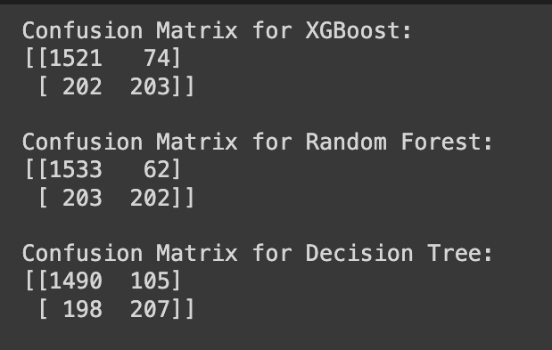
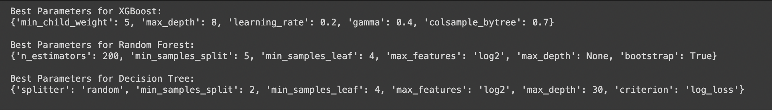
Results

Slide 11
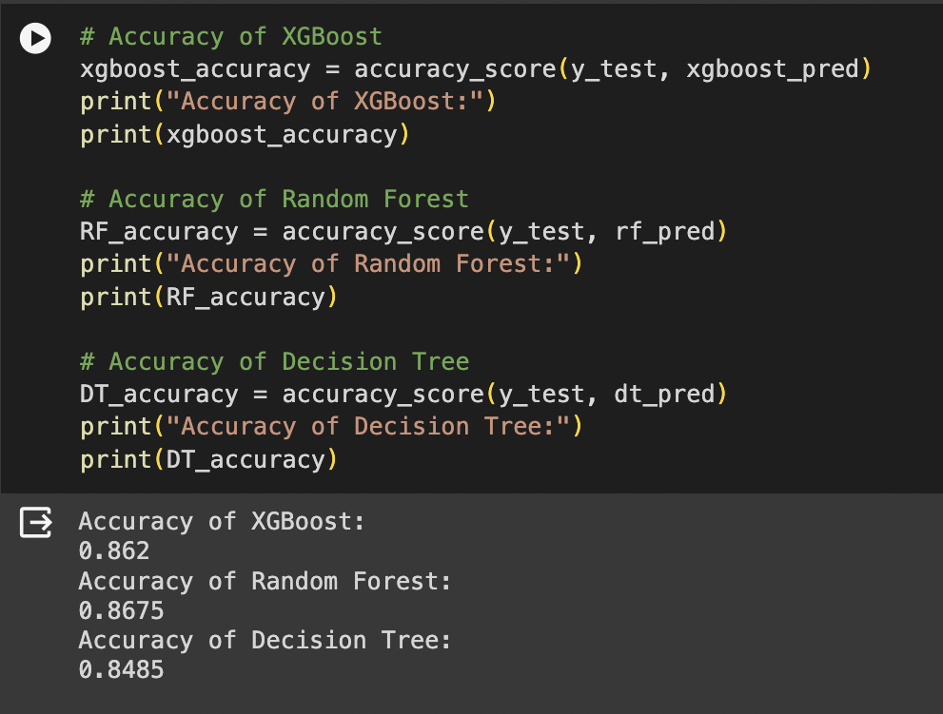
ACCURACY OF MODELS

Slide 12
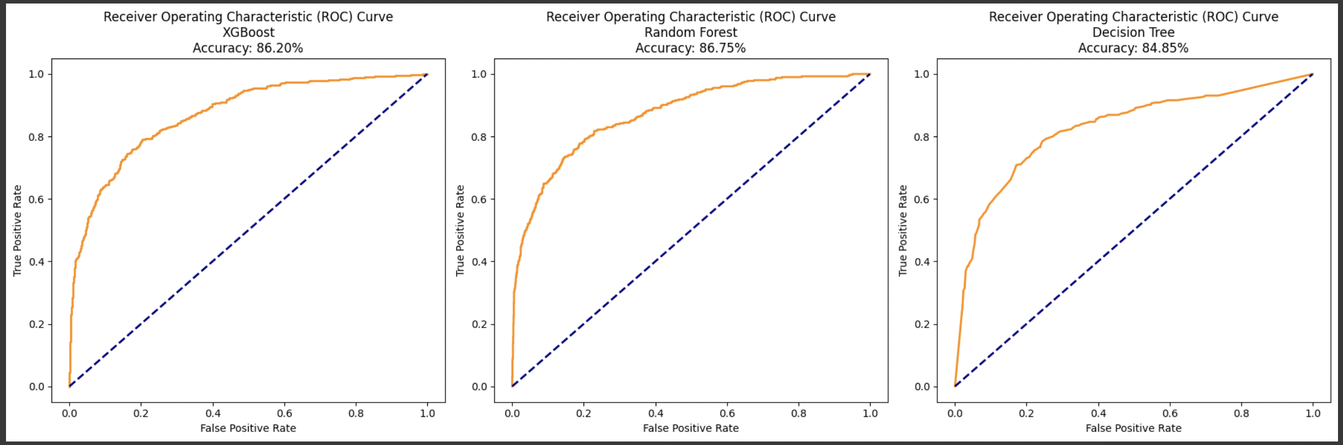
Results

Slide 13
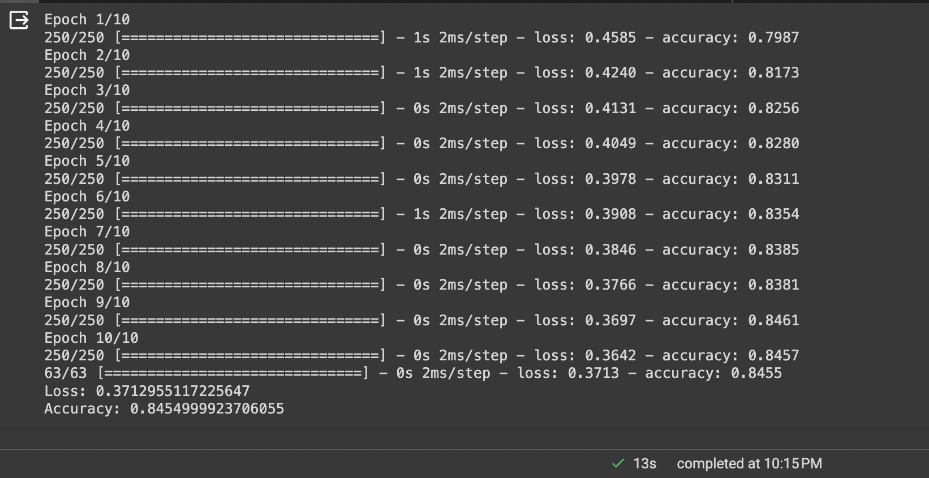
Trail Method(CNN)

Slide 14
Conclusion
We think Random Forest is the best model that can be used has a best tool for predicting customer churn for improving customer retention strategies in banks. The Future work for this will be collecting more data and train the model more so that we can increase the accuracy of our model. Once we have enough data, we are planning to train again training the neural network with that data. So, we can use the power of deep learning fully to have better accuracy which can integrating real-time data feeds to continually refine the model's predictions on the go.

Slide 15


